Slide 1
ESGF Scientific Contributions to Geoscience Research Communities
Task |  | R&D Area
1.1 |  | Data Management
1.2 |  | User Interface and Search
1.3 |  | Hardware & Network
1.4 |  | Data Transfer
1.5 |  | Installation (Containerized)
1.6 |  | Authentication & Authorization
1.7 |  | Federation
1.8 |  | Quality Control & Assurance
1.9 |  | Replication
1.10 |  | Distributed Search
1.11 |  | Metrics
1.12 |  | User Notification
1.13 |  | Long-tail Publication
1.14 |  | Distributed Computation
1.15 |  | Data Citation
2.1 |  | Provenance Capture
2.2 |  | Workflow
2.3 |  | Dynamic Resources
2.4 |  | In situ Analysis
2.5 |  | Machine Learning
2.6 |  | UQ
2.7 |  | Analytical Modeling
2.8 |  | Mobile Apps
Current capability status:
 | Usable
 | Prototype
 | Research activity
LLNL-PRES-732381
Ji-Woo Lee, Ph.D.
Lawrence Livermore National Laboratory
2017 Triennial Project Review, Potomac, MD
June 8 – 9, 2017
This work performed under the auspices of the U.S. Department of Energy by Lawrence Livermore National Laboratory under Contract DE-AC52-07NA27344
Notes:
Hello everyone, thank you for taking your time to attend this presentation. What I am going to present is about how ESGF would make scientific contribution to geoscience research communities.

Slide 2















ESGF software system and science integration
Operations
Geoscience research integration
Uncertainty Quantification
Community Machine Learning
Knowledge discovery
In situ analysis
Cloud technology
Visualization
Exploratory analysis
Analytical Modeling
Uncertainty
Quantification
Distributed
Computing
Community
Machine
Learning
Provenance
Capture
Long-tail
Publication
CDMS
Cloud
CMOR
Analytical
Modeling
CF
In situ
Analysis
Metrics
Research
Development
Notes:
I grabbed this side from Dean’s presentation which is showing software system and science integration of ESGF.
My work covers mostly on the research side, specifically for those three highlighted parts:
Geoscience research integration
Visualization
And Exploratory analysis

Slide 3
Purpose
Provide advanced tools for distributed big data analysis and visualization
Integrate into ESGF examples of complex but established analysis routines that can expedite research in diverse geoscience communities
Emphasize (but not limited to) capabilities designed for BER’s mission and projects (for example, CMIP, ACME, and PCMDI)
Notes:
Specified purposes are…

Slide 4


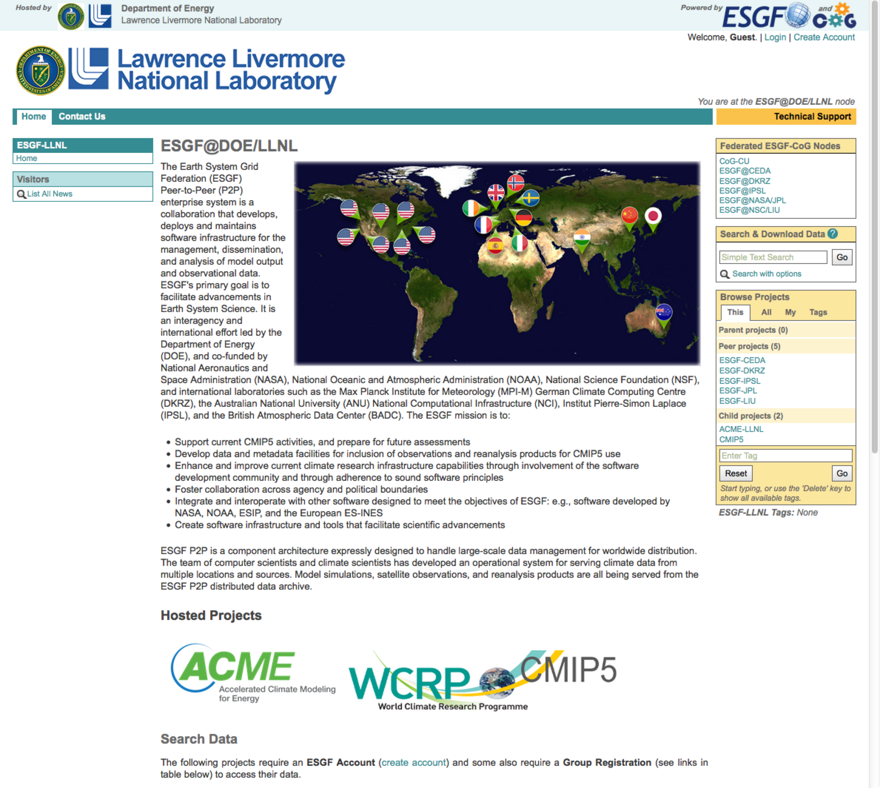
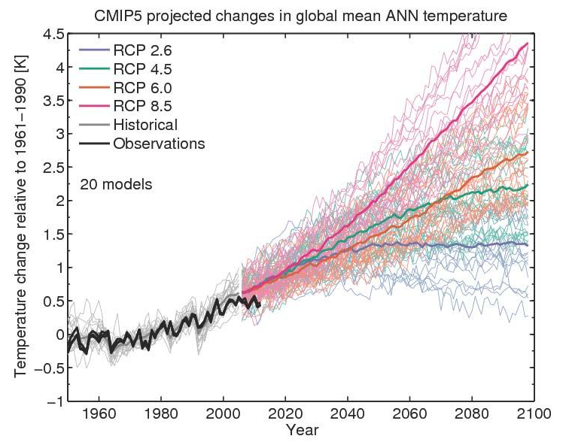
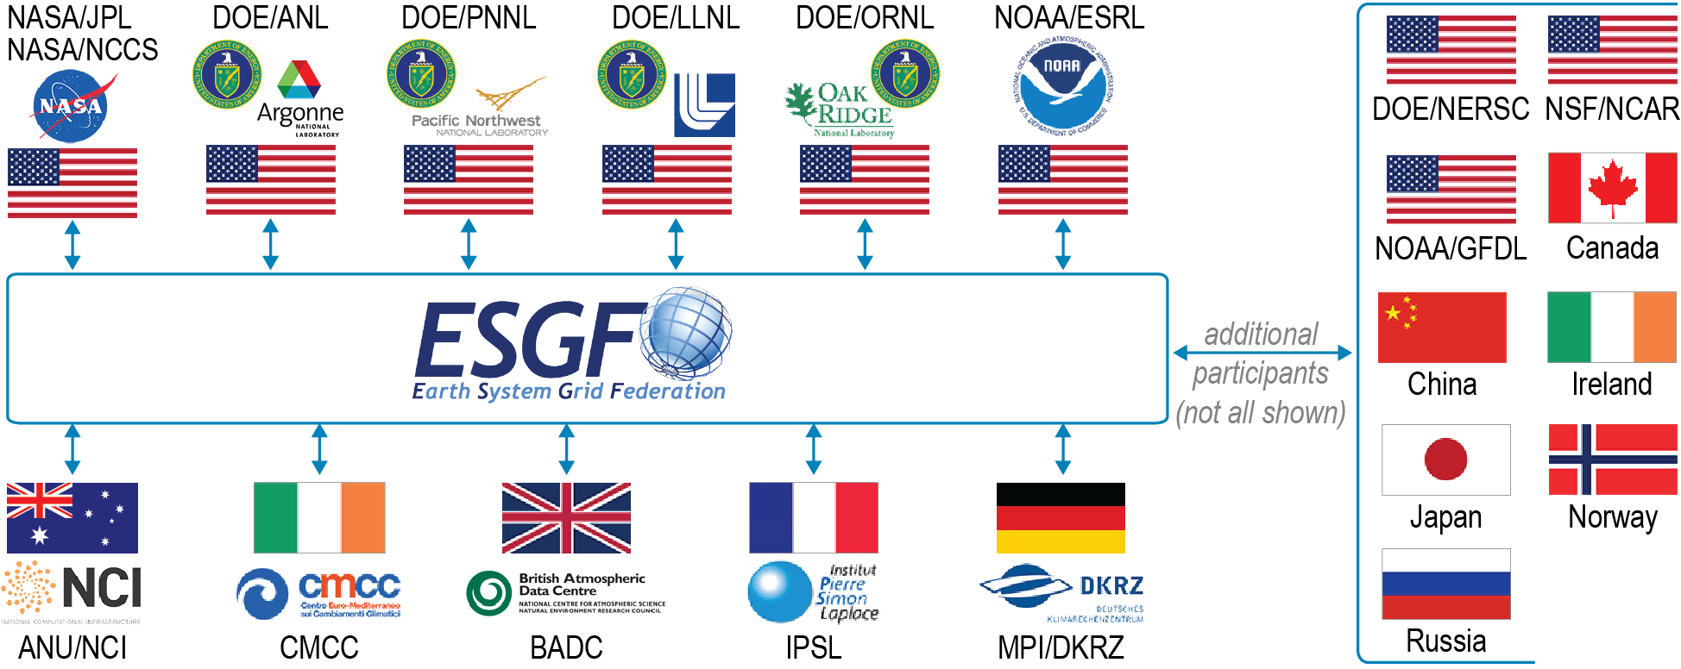
Metrics for Model Evaluation (1)
Coupled Model Intercomparison Project (CMIP)
ESGF
Hawkins and Sutton (2009)
ESGF data nodes and its web access
Future projections simulated by CMIP participating models
Notes:
One of major datasets that is distributed through the ESGF node is output from CMIP, the Coupled Model Intercomparison Project. The project has collected thousand terabyte of climate simulation if not petabyte. Simulations were conducted under a unified protocol that using same forcing. The target of the project is inter compare individual model to model and experiments to experiments, to separate natural climate variability and anthropogenically induced variability, thus to predict potential future climate scenario.
One of the main issues here is to identify model uncertainty. There is spread of line which indicate uncertainty in the future climate prediction. To have better idea what is contributing to the uncertainty, we have to evaluate individual climate model and should find which component of model causes weakness or strongest in their performance.
In this purpose, PCMDI and AIMS group have been collaborated to develop the software package of the climate model evaluation metrics, which is named PCMDI Metrics Package, PMP. The PMP goes through various variables of climate models and generate performance appraisal in very consistent and comprehensive way.
By having these three components all together, we can efficiently generate comprehensive performance report for previous and future CMIP projects even from ESGF server side.

Slide 5
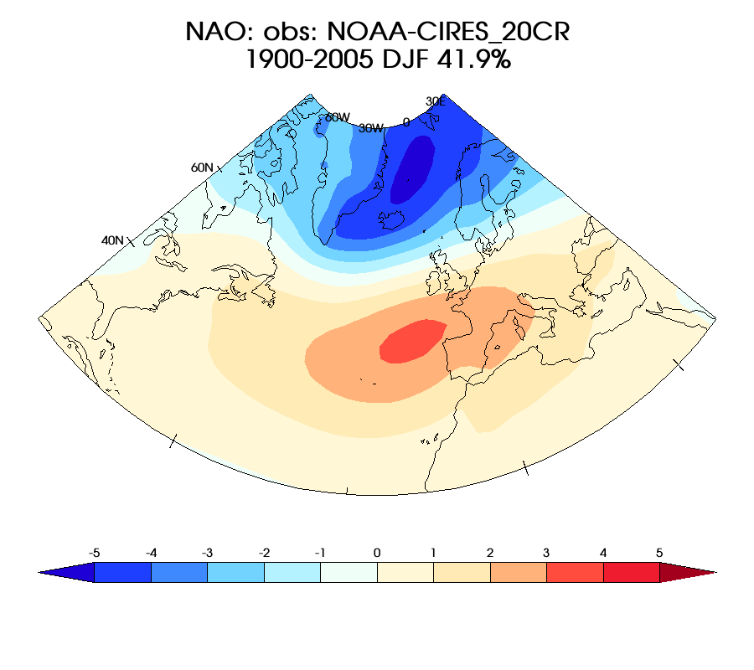
Metrics for Model Evaluation (2)
Interrogating models with observations
Modes * Seasons * Models * Their ensemble members * Metrics .. ~ 10⁴ images and statistics!
Notes:
Here is the one of examples that I have been working on recent days. This is newly developed evaluation metrics for the climate modes of variability. The mode of variability is a large scale pattern in the atmosphere or the ocean, which dominate variance over that region. I’ve selected five modes over the globe to build a metric, which are Pacific Northern American pattern, Pacific Decadal Oscillation, Southern Annular Mode, Northern Atlantic Oscillation, and Northern Annual Mode.
I will not going into detail but they are generally related to El Nino, hurricane track, jet stream and so on.
Let me take one, Northern Atlantic Oscillation, as a showcase. To evaluate Individual climate models, they have to be compared with the observation. This metric considers multiple modes, seasons, models, and their ensemble,
It ends up with more than 50K images and statistics, which means they cannot be summarized by conventional plots that has been used.

Slide 6
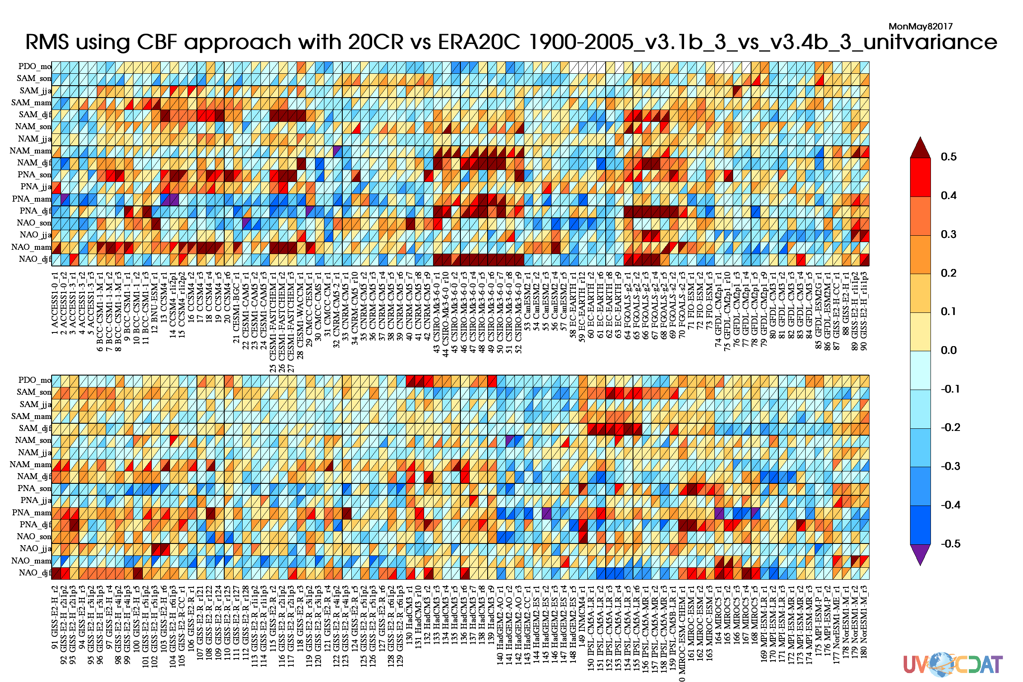
Metrics for Model Evaluation (3)
Goal: Enable user to apply new metrics and/or simulations across federation
Different aspects
Model Evaluation Metrics
(Unit variance EOF pattern)
Worse
ESGF
Multiple metrics / variables / seasons / etc.
Median
Better
All available (or user selected) models / datasets
User’s model
Notes:
Showcase plot…
Assume this work is done by individual researcher outside, that should be a massive work. They have to download all hundreds terabyte data and store those data in their side, organize the directory tree to handle dataset, and have to deal with lots of technical details.
We propose building this kind of comprehensive metrics from ESGF server-side. It would allow users upload their own metrics, or we can help them to build their newly developed metrics in ESGF side. The metric uploaded to the ESGF would be easily applied to Terabyte scale dataset archived in ESGF node if not more than Petabyte. This should be a win-win approach for both the research communities and us by building collaborative ecosystem.
With combining with CDP that Zeashaw presented, users would be able to easily add their own metrics on the ESGF node. That means, they will be easily apply their metrics to entire model data archived in the ESGF nodes, without downloading missive data on their local side.
Summerize 3K statistics in one plot… but only the statistics given by comparing obs to model... Another statistics of interests is comparing individual model to model

Slide 7
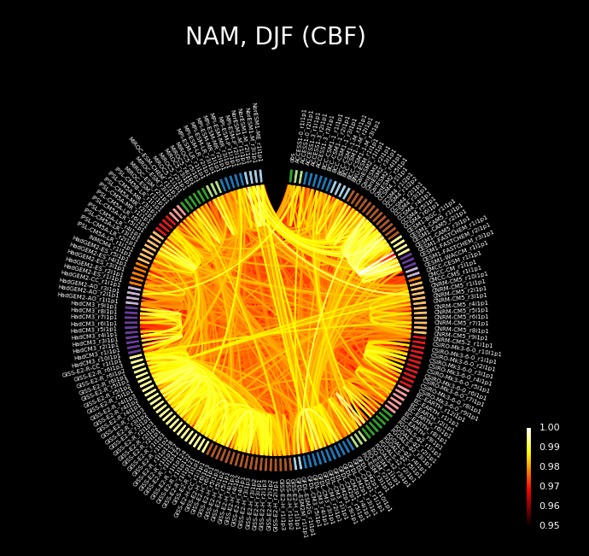
Metrics for Model Evaluation (4)
Dependency between models (Prototype)
Developing alternative way of big-data visualization for simulation performance and dependency testing
Example plot enables identifying dependency between models
Originally designed by bio-medical applications to identify connectivity between genes or cells
Summarizes relationship between more than 30K statistics in one plot
“perfect model” permutations via pattern correlation
Notes:
I am propose advancing visualization for performance appraisal …..
Circular plot…
Prototype.....

Slide 8
Scientific analysis examples (1)
CDAT is advanced and efficiently handle-able analysis tool
A foundation of robust tutorials and examples to enable rapid prototyping and development
Enable CDAT capabilities in geosciences, beyond BER
Notes:
One other effort is helping community to have advanced and efficiently handle able analysis tool.

Slide 9
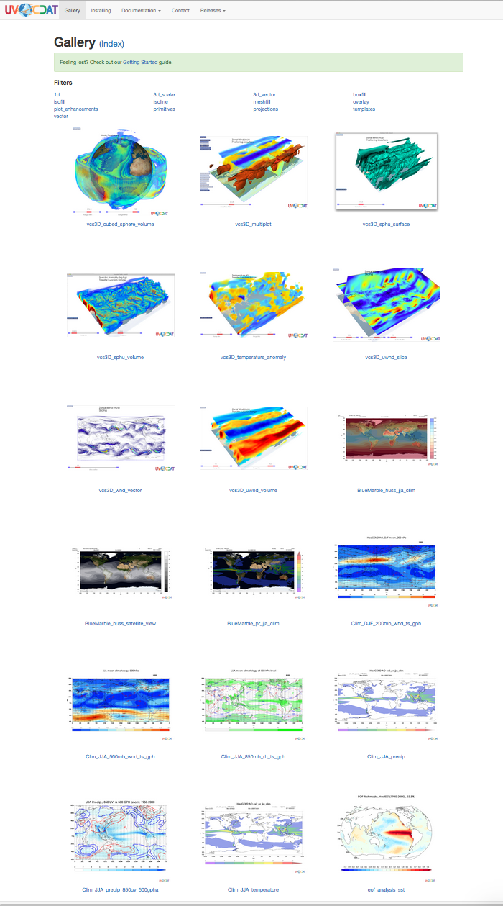
Scientific analysis examples (2)
Examples of frequently repeated analyses:
Seasonal climatology / anomaly
EOF analysis
Running average
Hovmoller & Taylor Diagram
Multi-model ensemble
Etc
https://uvcdat.llnl.gov/gallery.html
Notes:
There are some analyses that very frequently repeated from research communities, such as: …..
As an effort of helping the community, I have built scientific visualization examples for those analyses and they have been displayed on the UVCDAT website.
Users can click interested plot than the website provides description and Python code for creating that plot.
We will be adding more examples as further work.

Slide 10
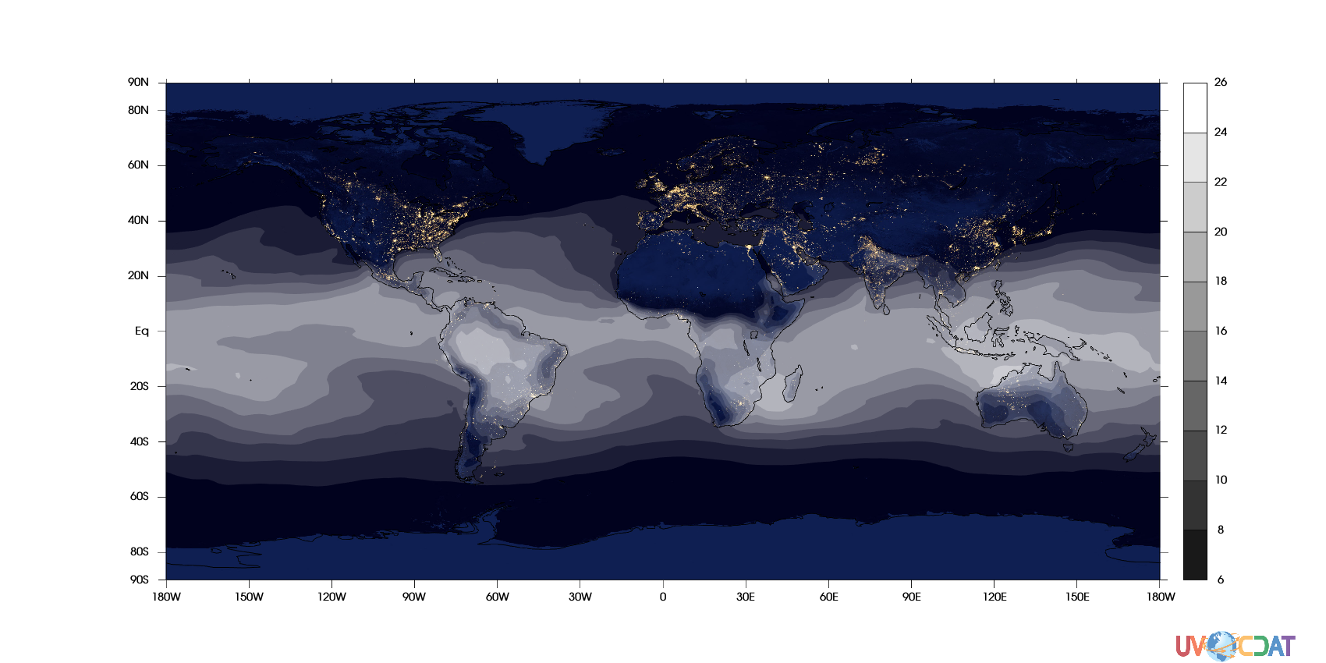
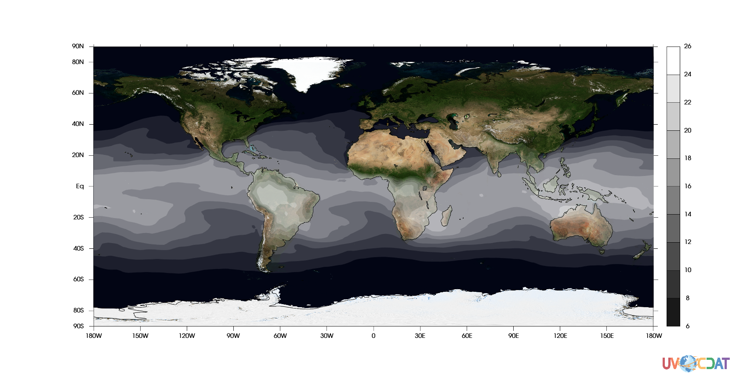
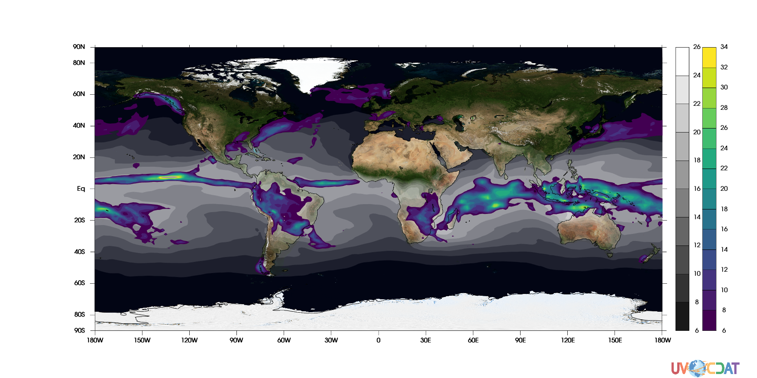
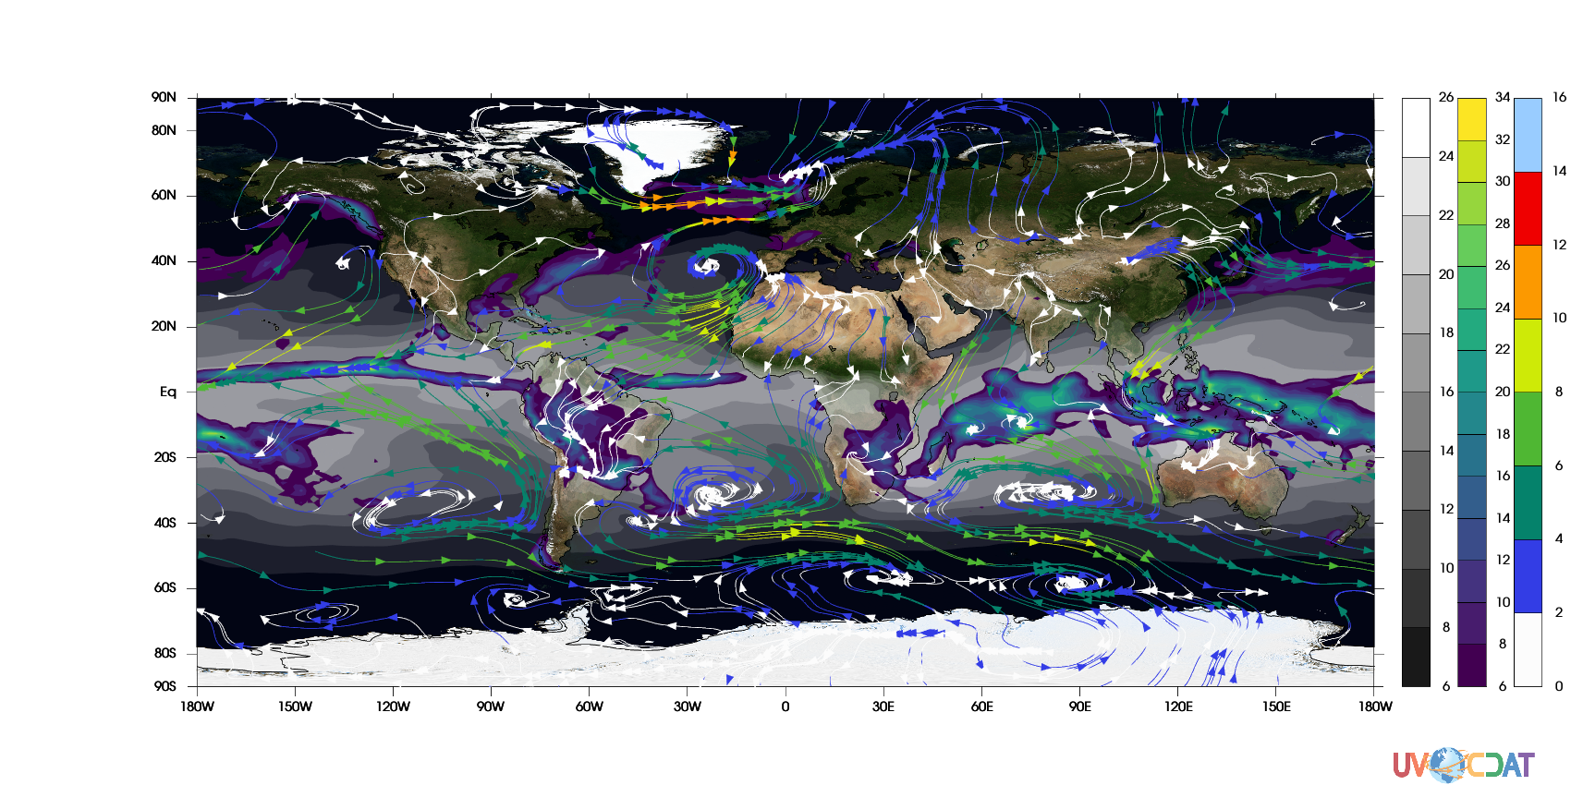
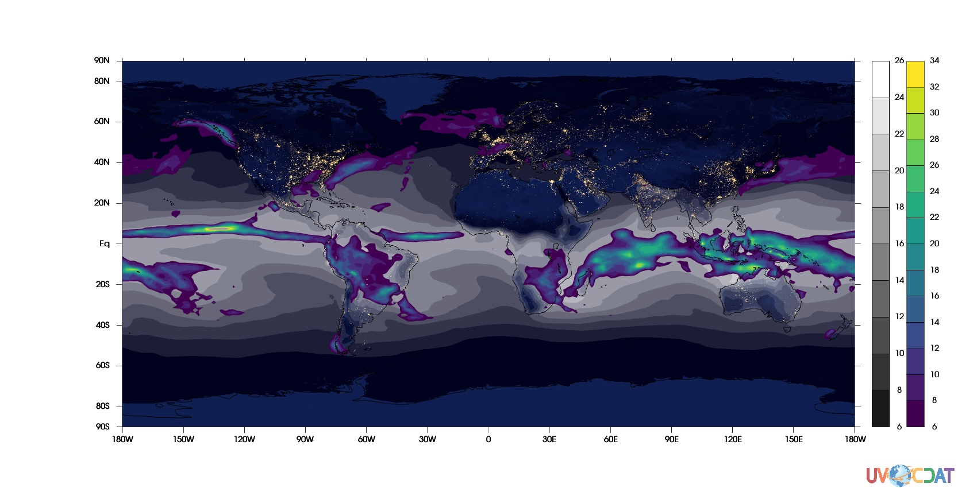
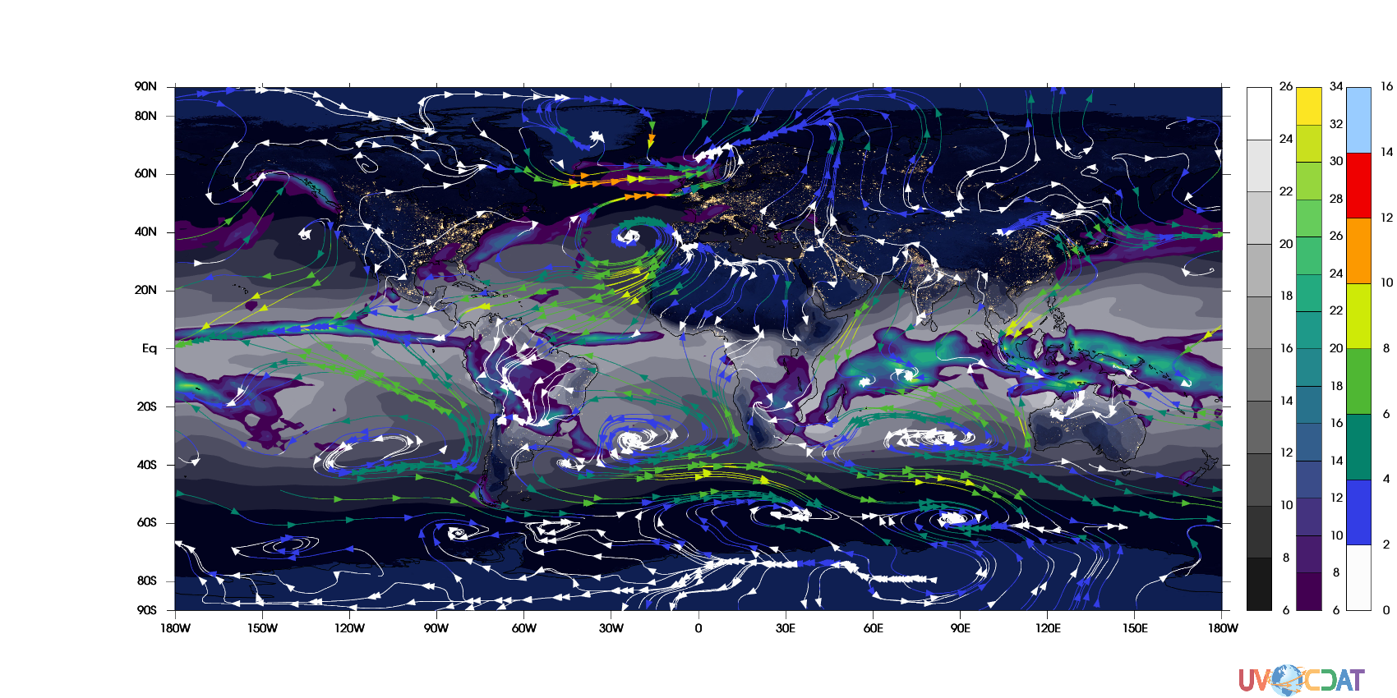
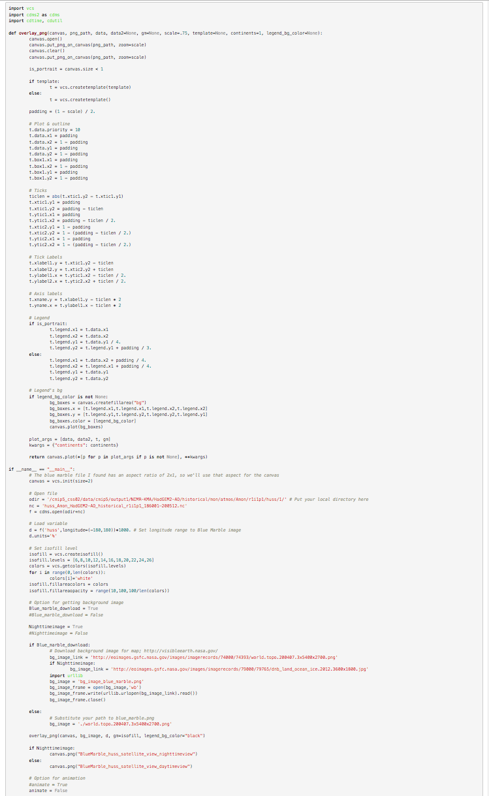
Scientific analysis examples (3)
Users can have self-describing Python source code and easily apply it to their analysis
Notes:
The strength of CDAT is …. Transpernecy.... Enables overlay.... Background map... Or plot multiple variables together on one scene...
As effort of helping the community, we are working on building example sets on the UVCDAT website. Here I selected some of most frequently applied analysis methodologies. Such as getting seasonal climatology or anomaly, getting running average also known as moving average
and writing professional but easily follow-able Python codes to make them happen.
Combining with user support and documentation work….

Slide 11
Scientific analysis examples (4)
Highlight of the example code:
import cdms2
from eofs.cdms import Eof
#Open file
:
# Load variable
d = …
:
# EOF (take leading mode)
solver = Eof(d, weights='area')
eof = solver.eofsAsCovariance(neofs=1)
# Plot
:
https://uvcdat.llnl.gov/examples/eof_analysis_sst.html
Notes:
One of example that I would like to highlight is “EOF analysis”.

Slide 12
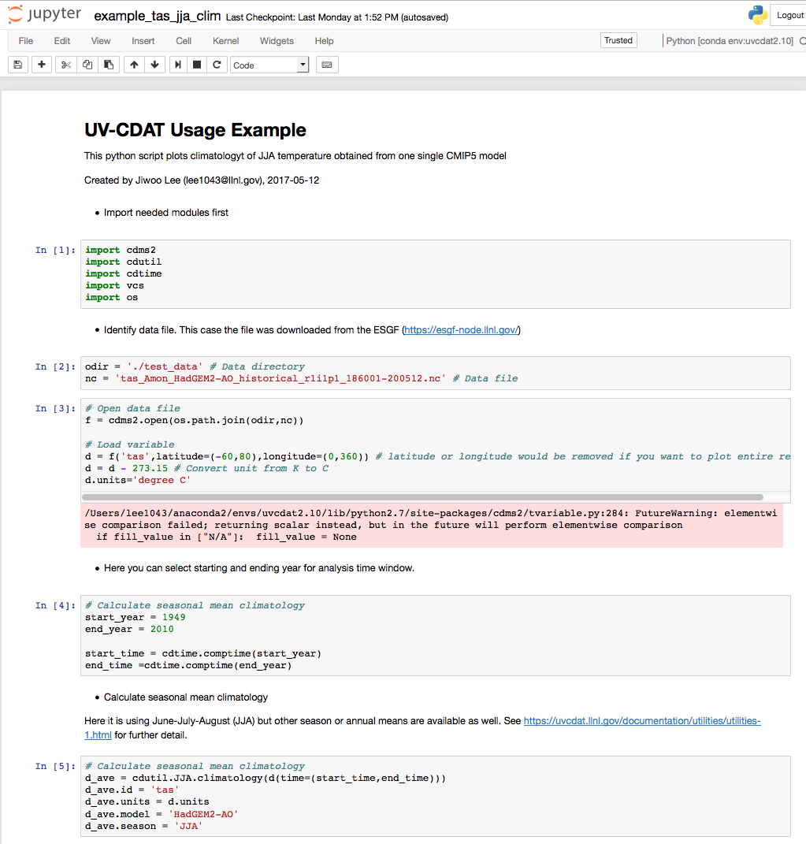
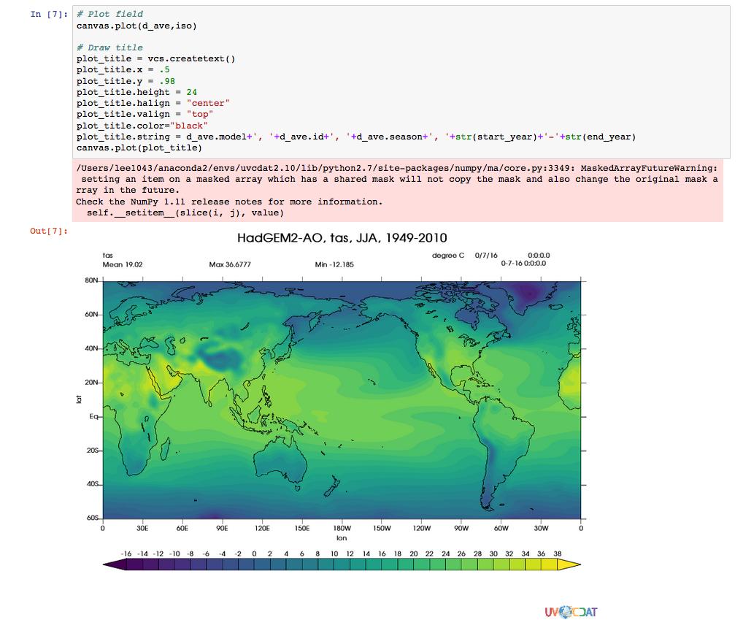
Server-side visualization for Exploratory Analysis
Jupyter Notebook Framework
Available to run on Web-browsers
Enables exploratory analysis (by implementing it on server side)
(Demo)
Notes:
Jupyter Notebook

Slide 13
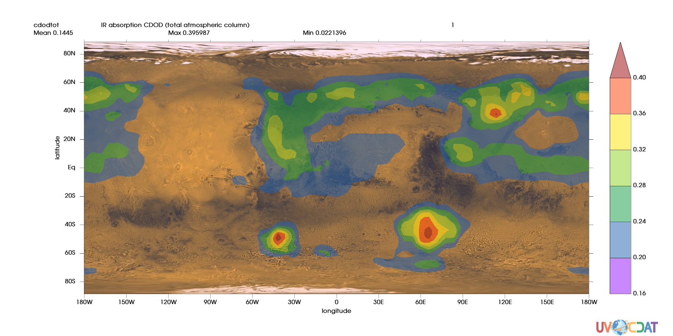
Documented examples for a diversity of geoscience communities
e.g., Visualization of Martian climate simulation
Courtesies:
- Data: Montabone et al.(2014) The Mars Analysis Correction Data Assimilation (MACDA) Dataset V1.0, Geo Data J
- Background image: NASA JPL and GSFC
Notes:
This plot is the example of CDAT application to other geoscience domain. It shows Infra-red radiation absorption by the Martian atmosphere, simulated by Mars model developed by a UK and French research team.

Slide 14
Summary and future work
Development of server-side model performance metric enables 1) Big data in-depth mining of (climate or other in ESGF) model data → Exploratory analysis 2) More systematic error characterization → Uncertainty Quantification
We will implement various metrics and visualizations on server-side
Scientific analysis examples for frequently repeated analyses has been developed
We will add more analysis examples recetly developed by research communities
Beyond the BER, diverse geoscience communities would take benefit of our work
We will find new capable areas where CDAT could be applied and advance
Notes:
Development of server-side model performance metric enables 1) users diagnosing strength or weakness of their models 2) providing guidance for model selection for researches on specific interests
Adding to the 1st bullet, “Categorizing those results and linking to model components will provide guidance for future model development”.
Adding to the 2nd bullet, “This will help researchers remain focused on their research instead of distracting themselves by reinventing wheels”.
Adding to the 3rd bullet, “I have no doubt that these works could be applied to various fields of geoscience for evaluating any models, intercomparing various types of observations, …..

